Slide 1
Keerthana Jothi
Analysis of SVM Models with different Kernels
Keerthana Jothi

Slide 2
Introduction
Objective: Build and evaluate SVM models with different kernels
Dataset: ClassificationDataset.csv
Target Variable: "Recurred" (binary classification - Yes/No)
Features: Mix of numerical (Age) and categorical variables (Gender, Smoking, etc.)

Slide 3
Data Preprocessing
Numerical Features (Age):
Standardized using StandardScaler
Categorical Features (all others):
One-hot encoded using OneHotEncoder
Train-Test Split:
70% training, 30% testing
Random state fixed for reproducibility

Slide 4
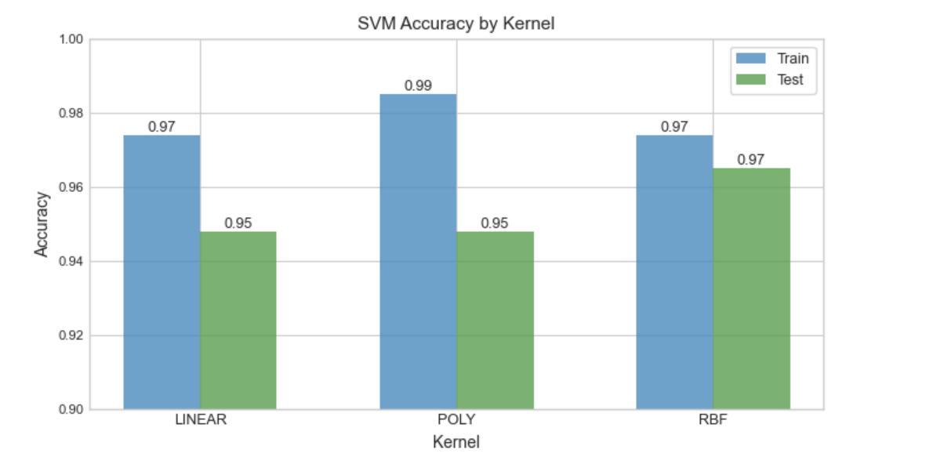
Model Performance Comparison
Kernel Training Accuracy Test Accuracy Train-Test Gap
Linear 97.76% 96.52% 1.24%
Poly 99.25% 97.39% 1.86%
RBF 96.64% 96.52% 0.12%
Best Performing: RBF kernel with 96.52% test accuracy Keerthana Jothi

Slide 5
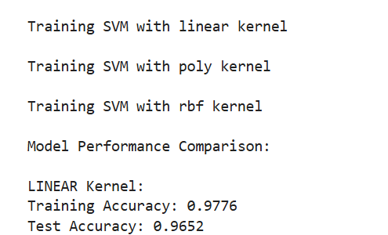
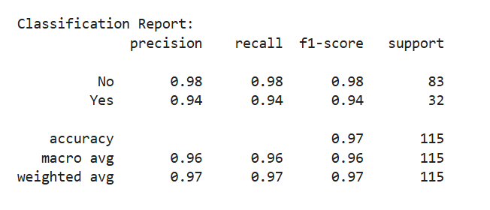
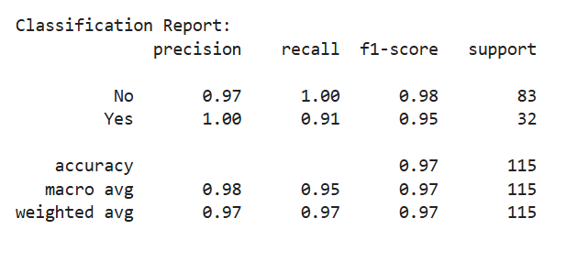


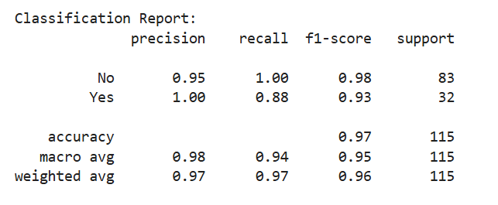

Slide 6
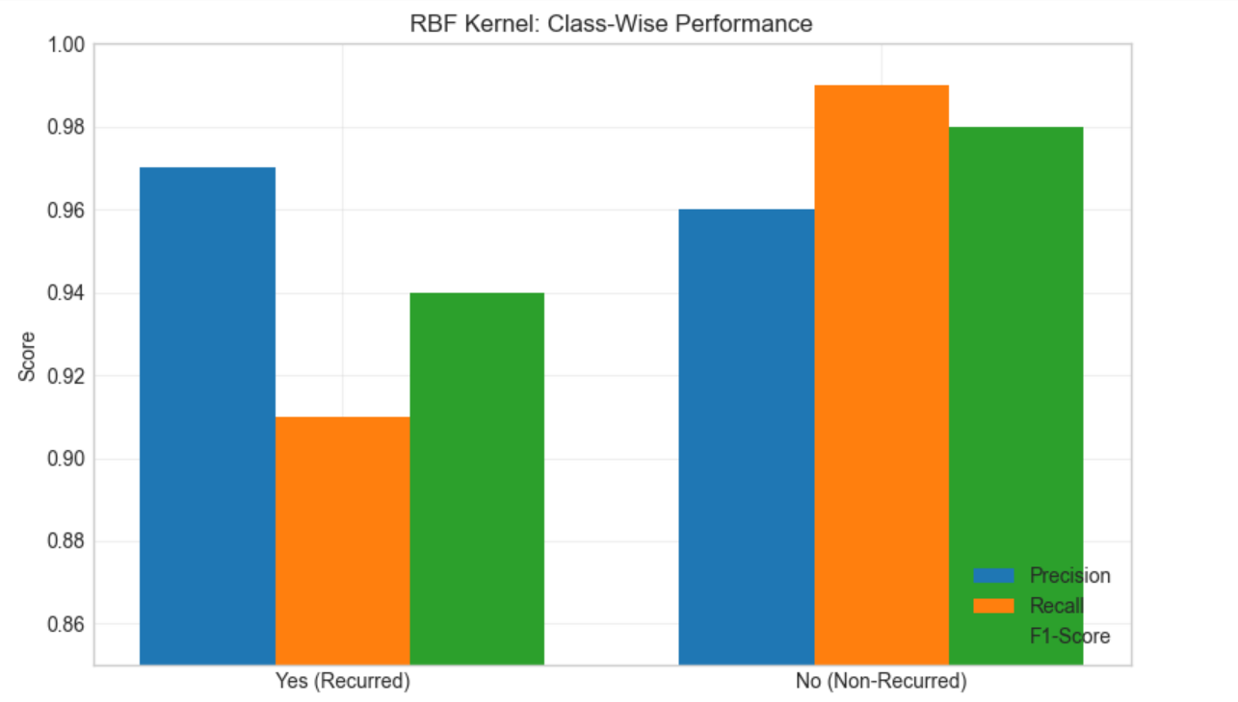
Classification Reports
RBF Kernel showed best balance:
Metric "Yes" Class "No" Class
Precision 97% 96%
Recall 91% 99%
F1-Score 94% 98%
All kernels showed good
performance with >94% accuracy
Keerthana Jothi

Slide 7
Bias-Variance Analysis
Best Bias-Variance Balance: RBF kernel
High test accuracy
Small gap between train and test accuracy
Slightly better than linear/poly kernels
Conclusion
The SVM (RBF kernel) is a strong candidate for this classification task, but further tuning can optimize performance for real-world deployment.

Slide 8
Thank You.

